Slide 1
Neural Network Hyperparameters
Lecture 17

Slide 2

Wednesday, September 25th
National Daughters Day
National Lobster Day
National Comic Book Day
National Quesadilla Day
Research Administrators Day

Slide 3
Hyperparameters are...

Slide 4
Hyperparameters are...
Parameters that the engineer sets
Generally, the model is not adjusting them during training

Slide 5
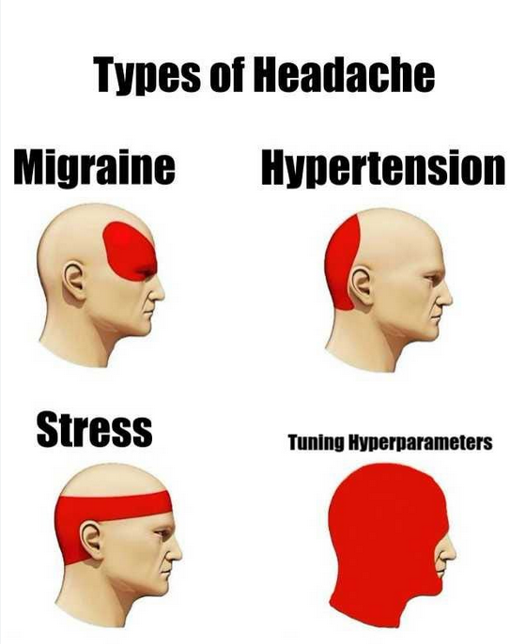
Neural Network Hyperparameters
There are a lot of them
Tuning them is often the majority of what you will be doing
https://medium.com/@dyllanjrusher00/dont-get-stuck-tuning-hyperparameters-c9d2b29f004d

Slide 6
Neural Network Hyperparameters
Number of layers
Number of nodes in each layer
Activation function selection
Regularization
Cost/Loss/Error function selection
Batch size per error backpropagation
Learning rate and/or optimizer
Number of epochs
Data Augmentation

Slide 7
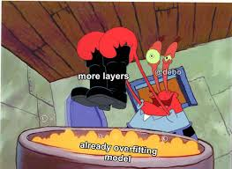
Number of layers
When we refer to neural network "deepness", we are usually referring to how many layers are in the network, rather than how many nodes per layer
Though deepness is more realistically a function of both
RULE OF THUMB (this is just typical! Not true in all cases!)
  More layers = more capacity to learn
  More layers = better for large amounts of data/high dimensional data
  More layers = higher chance of overfitting
  More layers = more training time
https://www.facebook.com/convolutionalmemes/posts/follow-us-on-instagramhttpswwwinstagramcomrealmlmemes-debojeet/1326047464516417/

Slide 8
Number of nodes in each layer
Hard to figure out how to set this
RULE OF THUMB: More nodes in a layer at beginning of network, less near end
Assuming we have sort of a feature pyramid
  Start with "low level" features
  Turn into progressively more informative features
End with usually same number of nodes as output classes

Slide 9
Example: Neural Network for Medicine Dispersal
Which, by the way, is probably a terrible idea
Input: patient biometrics
  Body temperature
  Heart Rate
  Sinus Pressure
  Blood Pressure
  Skin appearance
  Skin feeling
  Tonsil size

Slide 10
Layer 1
We hope it finds symptoms:
  Body temp > 101 = fever
  Tonsil size abnormal AND sinus pressure= sore throat
  Skin appearance is red AND skin feeling is itchy = rash

Slide 11
Layer 2
We hope maybe it makes a diagnosis distribution
  Inputs: Rash, sore throat, fever
  Output – strep throat 80% OR tonsillitus 50% OR common cold 10%

Slide 12
Output layer
Input: percent confidence of each disease
Output: medication is recommended (antibiotics)

Slide 13
Feature engineering
We don't know what's actually going on under the hood for a neural network
We are sort of assuming it's doing this automatically
It probably isn't
But kind of the assumption goes more low level info -> more higher level info -> output
Feature engineering can be done for lots of models including neural networks, but is less common than with other approaches

Slide 14
Activation Function
Sigmoid
Tanh
Relu
Leaky Relu
Softmax

Slide 15
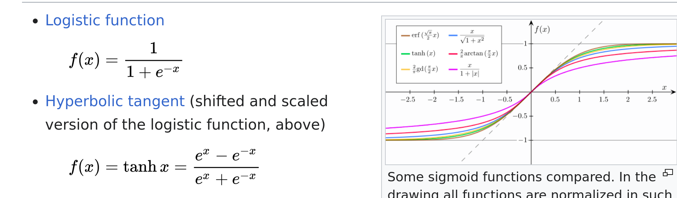
Sigmoid Function and Tanh
Quashes between 0 and 1 (sigmoid) -1 and 1 (tanh)
Saturates quickly
https://en.wikipedia.org/wiki/Sigmoid_function

Slide 16
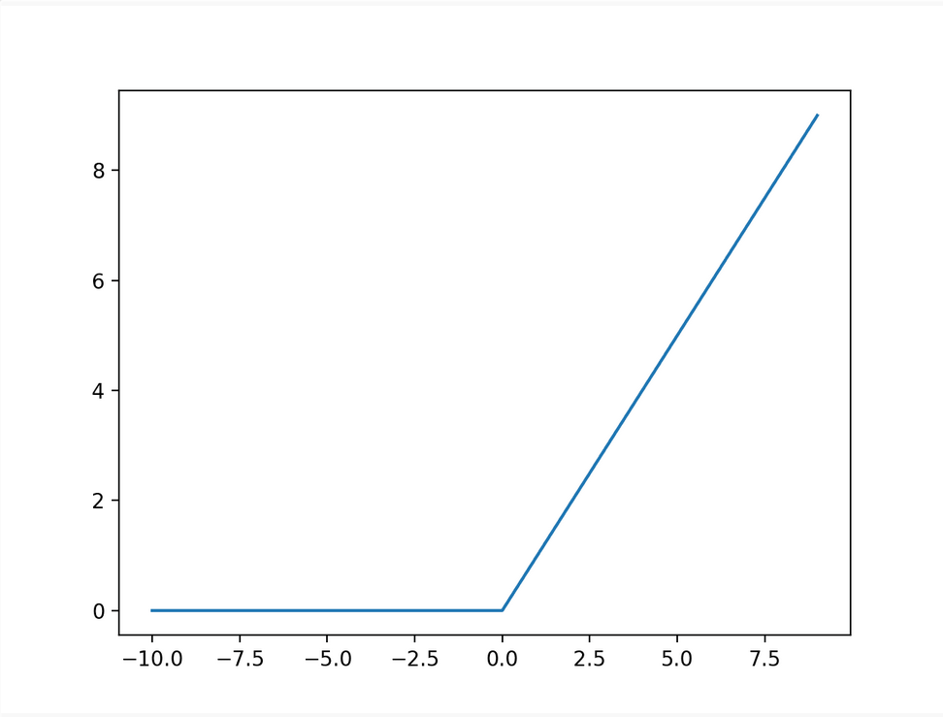
ReLU
Rectified Linear Unit
If input <= 0 = 0
Otherwise input = 0
Output is positive or 0
Very popular and often the default
https://machinelearningmastery.com/rectified-linear-activation-function-for-deep-learning-neural-networks/

Slide 17
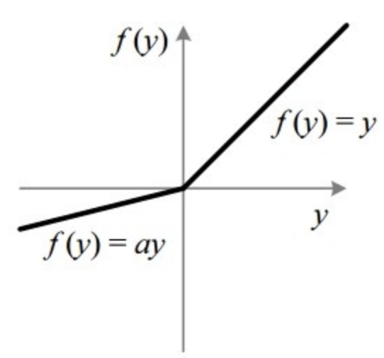
Leaky Relu
Allows some small negative numbers
https://paperswithcode.com/method/leaky-relu

Slide 18
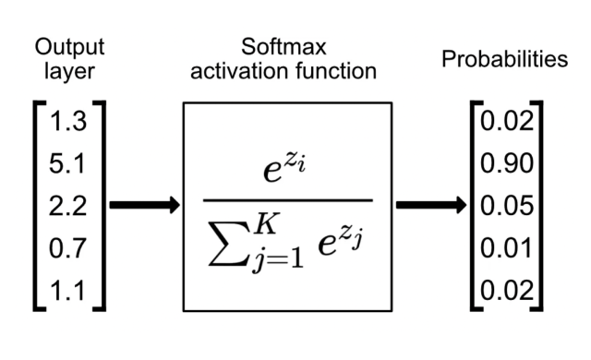
Softmax Function
Popular for one-hot encoded classification problems
Turns all outputs into probabilities that sum to 1
https://www.singlestore.com/blog/a-guide-to-softmax-activation-function/

Slide 19
Regularization
Exploding and Vanishing Gradients for Large Errors
Add a penalty term (often L1 or L2 norms) to error function
Has the effect of shrinking weights that don't contribute much
Dropout – randomly drop some connections during training (noisy)
Regularization quite often improves neural network performance
https://theaisummer.com/regularization/

Slide 20
Cost/Loss/Error Function Selection
MSE
MAE
RMSE
Cross Entropy

Slide 21
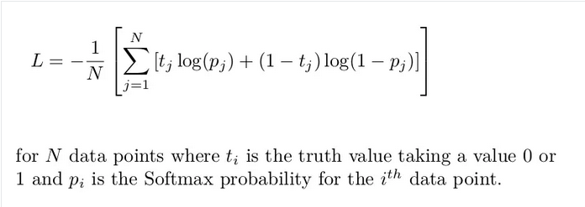
Cross Entropy Function
Looks at difference between two distributions
Also comes out of information theory
Also popular, especially with high dimensions
https://www.datacamp.com/tutorial/the-cross-entropy-loss-function-in-machine-learning

Slide 22
Batch Size
Batch gradient descent – how many examples do you want to average the error over?
Usually implement in powers of 2 (32, 64, 128, etc)
Larger batches -> less backprop -> more averaged -> usually faster
May lose some info, have a higher memory cost (run things in parallel)
Smaller batches -> more backprop -> takes longer to train

Slide 23
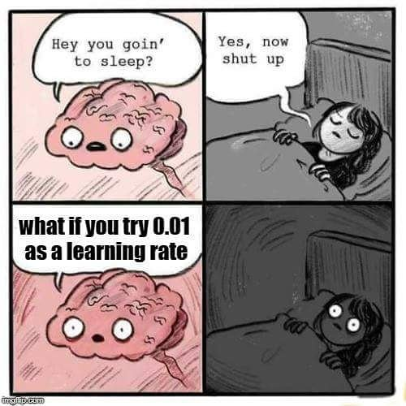
Learning Rate
Step size of weight/bias adjustment
Usually a very small number
Often adjust it by powers of 10 (1e-4, 1e-5, etc)
Tricky because
  Want it to converge fast
  But don't want to get stuck in a local minimum
https://x.com/mlinterview/status/993257627244204032

Slide 24
Optimizers
Adjust your learning rate based on the performance of the neural network
Momentum
RMSProp
Adam

Slide 25
Momentum
Incorporates information about the last weight update into the current weight update
Gain "momentum" by doing so
More robust to noise
https://medium.com/@vinodhb95/momentum-optimizer-6023aa445e18

Slide 26
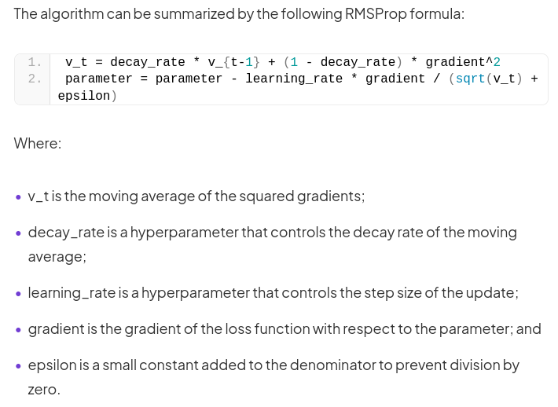
RMSProp
Moving average of gradients to control weight update
https://deepchecks.com/glossary/rmsprop/

Slide 27
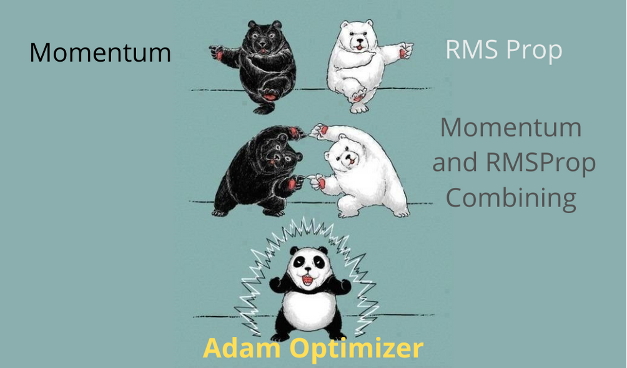
Adam
https://datamonje.com/gradient-descent-and-variants/

Slide 28
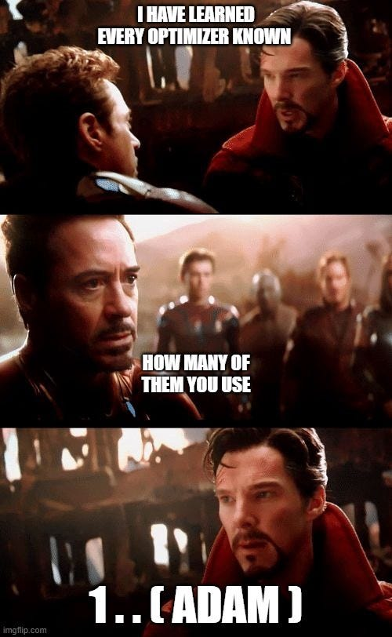
Adam
Hard to overstate the popularity of this one
Doesn't mean you have to use it
But it tends to do well, so everyone and their dog uses it
https://medium.com/analytics-vidhya/mechanism-of-gradient-descent-optimization-algorithms-7baed9c9c35e

Slide 29
Number of Epochs
How many times do you let your neural network train on the complete set of training data (different from number of batches)
Early stopping – using the validation set, most often
Usually set this rather than trying to get to a certain accuracy
Often a trial and error process

Slide 30

Data Augmentation
Taking your existing data
Changing it slightly so it's "new"
Suddently you have more data
Very often used for convolutional neural networks
https://medium.com/analytics-vidhya/data-augmentation-keras-in-nutshell-theory-98c2e865abce

Slide 31

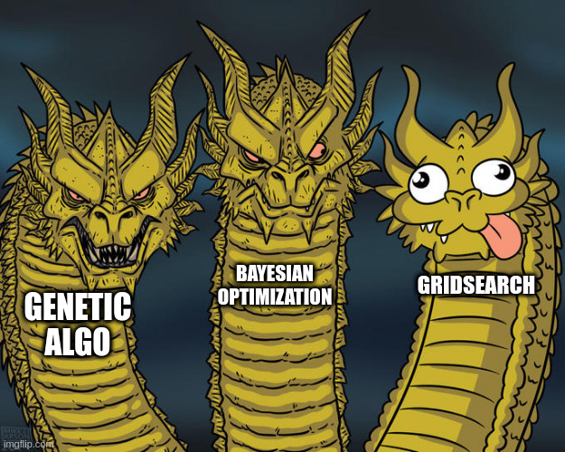
How to find the best hyperparameters
Guess what
This is not a solved problem
Trial and Error
Maybe Grid Search
Maybe NAS
https://clear.ml/blog/how-to-do-hyperparameter-optimization-better
https://clear.ml/blog/how-to-do-hyperparameter-optimization-better

Slide 32

If at first you don't succeed...

Slide 33
If at first you don't succeed...
Then you will probably understand that machine learning is a LOT of trial and error

Slide 34
Questions?

